Slide 1

POSEAI Intelligent Gym Form Correction and Workout Feedback System
School of Computer Science and Engineering
Department of Computer Science and Engineering
:
Submitted by :
Saiyyam Jain
2427030340
Supervised By:
Dr.Atul Kumar Verma

Slide 2
OUTLINE
01
02
03
04
05
INTRODUCTION
LITERATURE
REVIEW
PROBLEM
STATEMENT
PROPOSED
SOLUTION
OBJECTIVES

Slide 3
01
INTRODUCTION

Slide 4
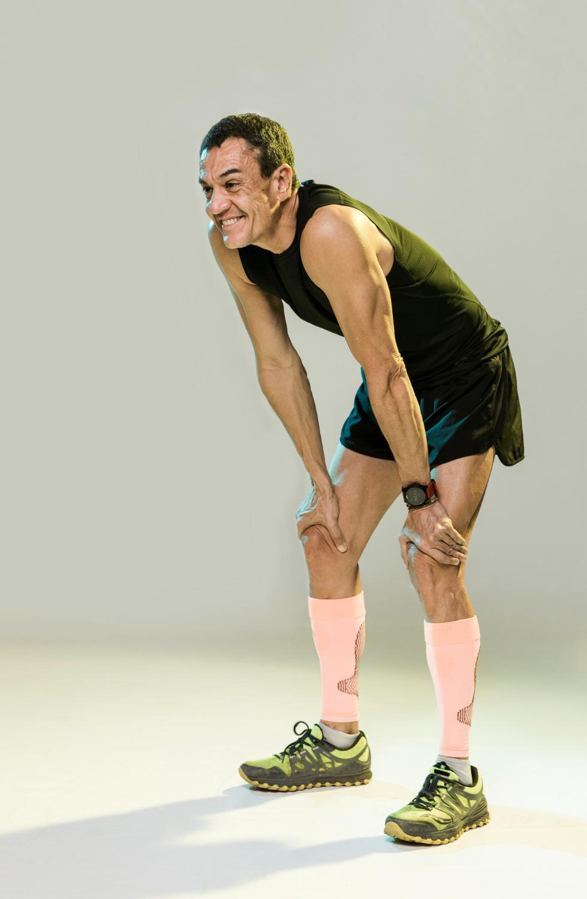
Fitness and gym training are increasingly data-driven, yet most users lack personal guidance.
Incorrect exercise posture leads to injuries, reduced efficiency, and long-term health issues.
Pose estimation and AI-based feedback can bridge the gap between trainers and individuals.
PoseAI is a real-time AI system that detects, analyzes, and corrects human body posture during workouts using computer vision.
It provides instant feedback and long-term performance tracking via a web dashboard.

Slide 5
02
LITERATURE REVIEW

Slide 6
Overview
Existing Systems
Research Gap
OpenPose (CMU) – pioneering multi-person 2D pose estimation.
MediaPipe (Google) – real-time, lightweight body tracking.
Pose Trainer (arXiv 2020) – uses pose estimation for exercise form analysis.
GymScore.AI, Arthlete,FormCoach– provide form analysis but lack adaptive feedback.
Require strong hardware or cloud servers for processing.
Feedback is static (“good/bad posture”) and not personalized.
No existing platform integrates:
1)Adaptive learning feedback
2)Explainable AI visual guidance
3)Holistic integration
(diet,analytics, voice assistance)

Slide 7
03
PROBLEM STATEMENT

Slide 8
Most gym users perform exercises with improper posture due to lack of personal trainers, leading to injuries and inefficiency. Existing fitness apps give generic or static feedback and rely on costly sensors or cloud systems. Hence, there is a need for an affordable, adaptive, real-time AI system that provides personalized posture correction using only a camera.

Slide 9
04
PROPOSED SOLUTION

Slide 10
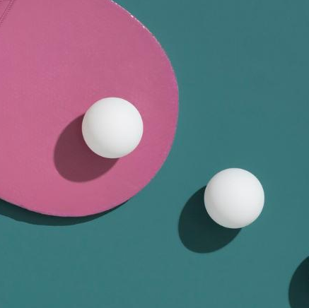
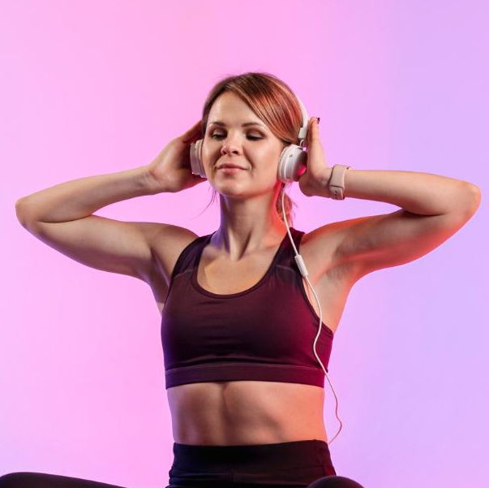

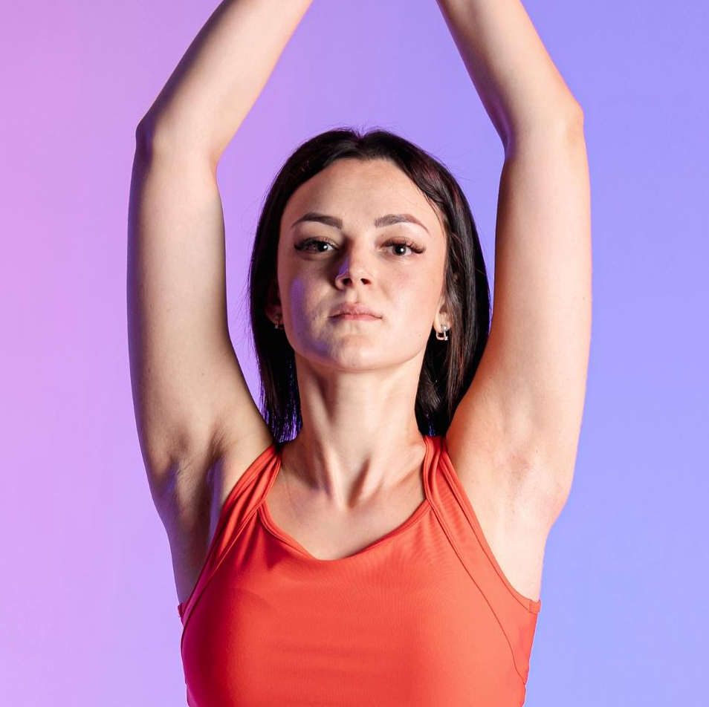

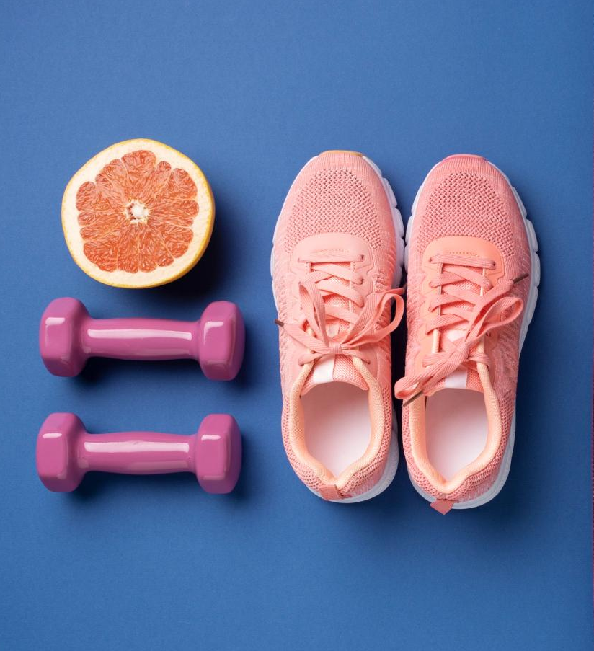
CONCEPT
1
Your username
PoseAI is an AI-powered web platform that:
Detects human pose using MediaPipe/OpenPose.
Calculates joint angles and compares with ideal posture.
Gives instant feedback via visual and audio cues.
Tracks progress through an interactive analytics dashboard.
2
3

Slide 11
METHODOLOGY
Steps:
Capture user video (webcam/upload).
Extract body landmarks (AI model).
Compute joint angles and detect deviations.
Generate correction feedback.
Display analytics and improvement trends.

Slide 12
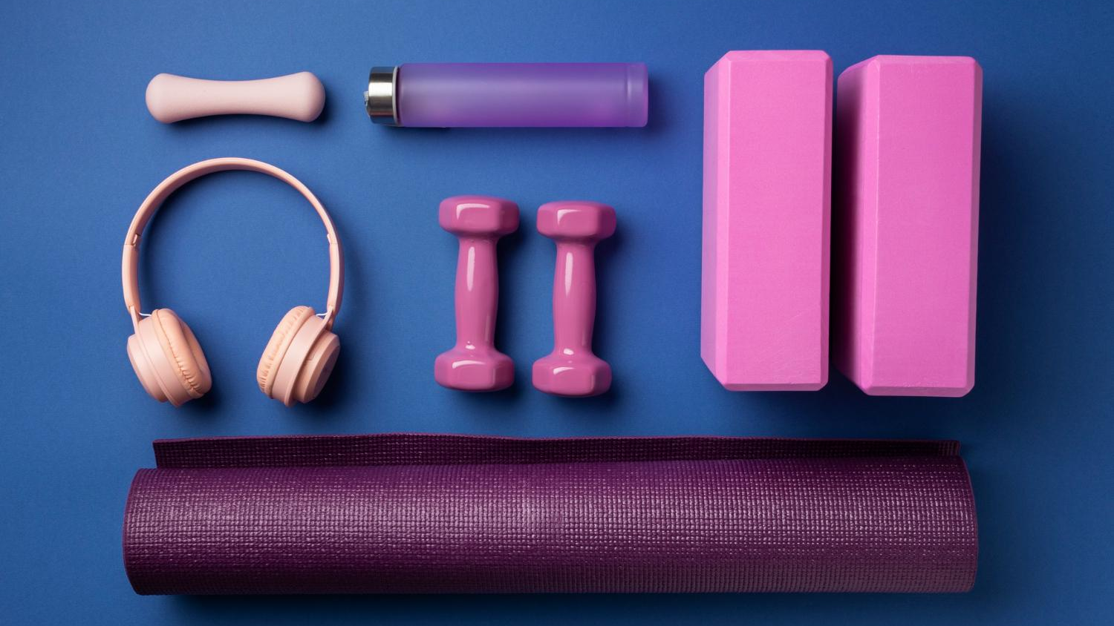
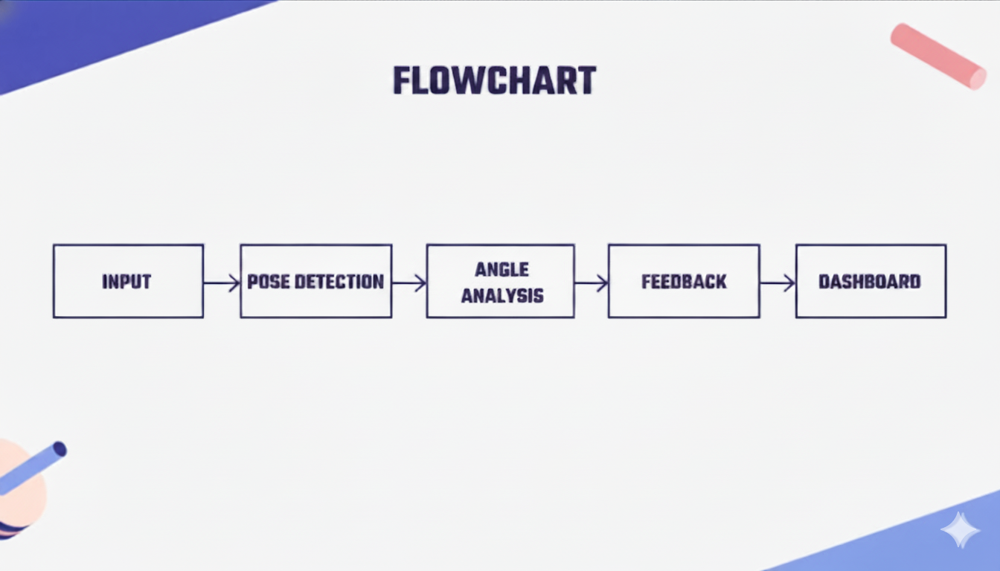
Social media is all about people

Slide 13
05
OBJECTIVES

Slide 14
To develop an AI model for accurate pose detection and angle estimation.
To provide real-time posture correction with adaptive feedback.
To create a full-stack web dashboard for progress tracking and visualization.

Slide 15
06
FUTURE WORK

Slide 16
1. Backend Integration
Implement user authentication system
Store workout history in a database
Enable long-term progress tracking
2. Multi-Exercise Detection
Extend system to detect multiple exercises such as push-ups, lunges, planks, and yoga poses
Use motion pattern recognition for automatic exercise identification
3. Machine Learning-Based Posture Classification
Replace rule-based angle thresholds with trained ML models
Use datasets of correct and incorrect postures for training
4. Personalized AI Feedback
Develop adaptive feedback system based on user performance history
Provide customized corrections for individual users
5. Injury Risk Prediction
Analyze joint stress patterns over time
Provide early warnings to prevent injuries
6. Integration with Fitness & Diet Planning
Recommend workouts based on user goals
Provide personalized diet suggestions

Slide 17
06
CONCLUSION

Slide 18
The project “PoseAI – AI Based Gym Form Correction System” demonstrates the effective use of computer vision and artificial intelligence in the fitness domain. The system successfully captures real-time video input, detects human body posture using pose estimation techniques, and provides instant feedback to improve exercise form.
By utilizing the MediaPipe BlazePose model, the system extracts body landmarks and applies biomechanical analysis to calculate joint angles. Based on these calculations, PoseAI evaluates posture correctness, counts repetitions, and computes performance accuracy.

Slide 19
WEBSITE LINK
https://saiyyamj.github.io/poseai/

Slide 20
REFERENCES
Cao, Z. et al. “OpenPose: Real-Time Multi-Person 2D Pose Estimation.” IEEE TPAMI, 2019.
Google MediaPipe Documentation – https://developers.google.com/mediapipe
“Pose Trainer: Correcting Exercise Posture Using Pose Estimation,” arXiv, 2020.
UCF101 Dataset – https://www.crcv.ucf.edu/data/UCF101.php

Slide 21
THANK YOU SAIYYAM JAIN 2427030340

